Slide 1

What is Backyard Permaculture?
Jacqueline M. Millar
Co-Founder Terra Cura Inc.

Slide 2
Origins of Permaculture
Permaculture was created in the 1970's by Bill Mollison, an Australian ecologist and University of Tasmania professor. He had spent many years out in nature as a wildlife biologist observing how natural systems work and became very distressed at the destruction that he saw going on around him.

Slide 3
What is Permaculture?
Earth Care-Provision for all life systems continue and multiply, includes living and non-living things.
People Care-Provision for all people to access those resources necessary for existence, promote self reliance and community responsibility.
Fair Share-By governing our own needs, set resources aside to further the above ethics.

Slide 4
Backyard Permaculture
-Organic Food Production Garden
-Herb Spiral
-Rain Barrel
-Reuse and Recycle
-Bee Keeping
-Chickens
-Mushrooms
-Compost System
Notes:
Work with Nature-more hammock time.

Slide 5
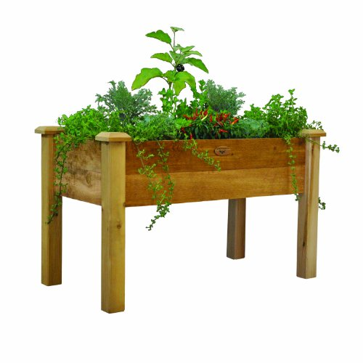
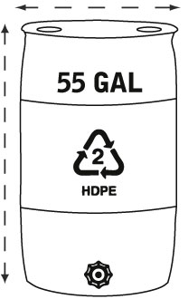
The Problem is the Solution
Be a Producer not
A Consumer
Catch and store
energy and water.
Be producers not consumers.

Slide 6
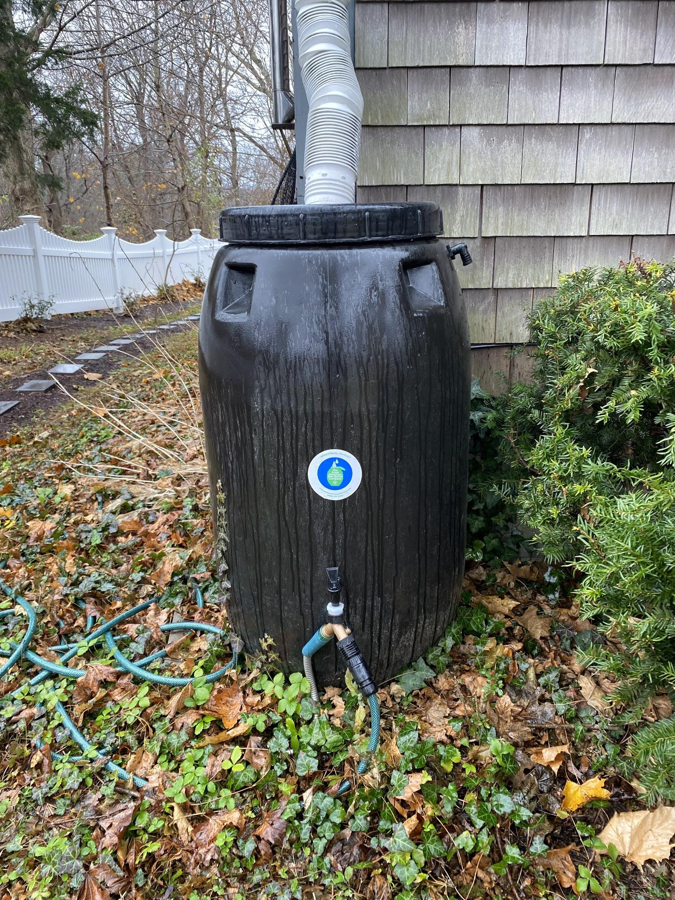
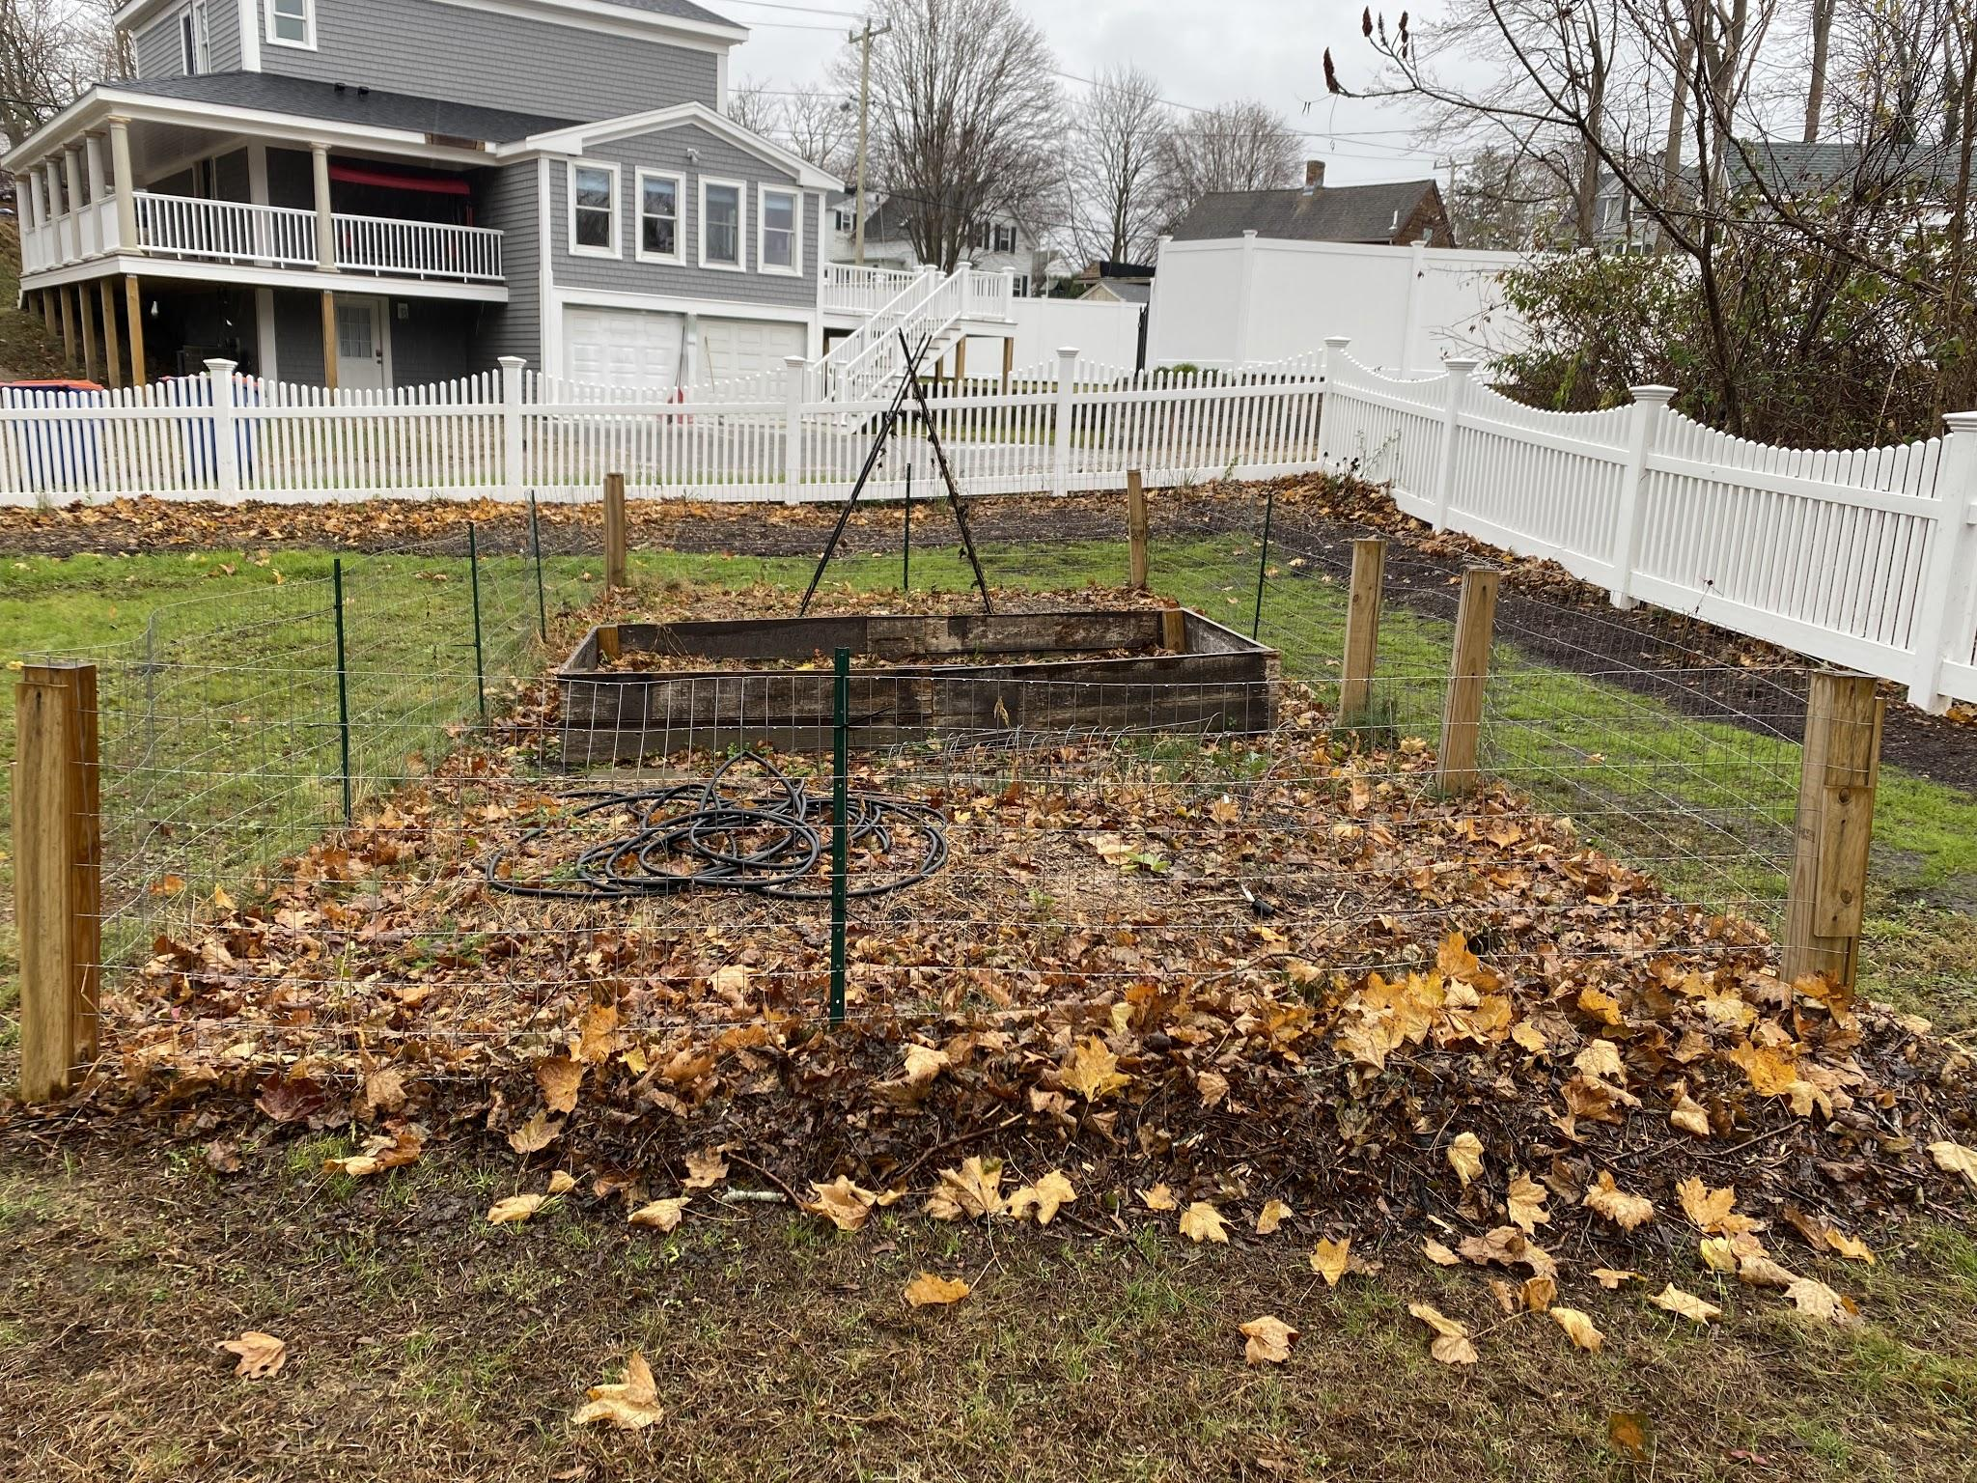
Garden &
Rain Barrel
Notes:
Plymouth rain barrel program through the Great American Rain Barrel company

Slide 7
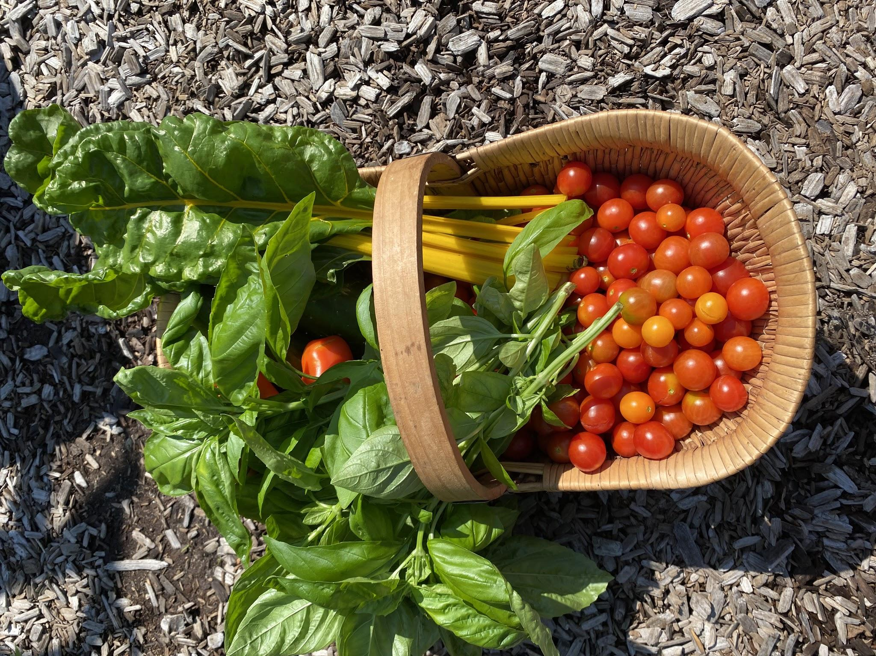
Organic Food Production
Notes:
Use companion [planting methods, three sisters gardens, compost, drip irrigation from your rain barrel.

Slide 8
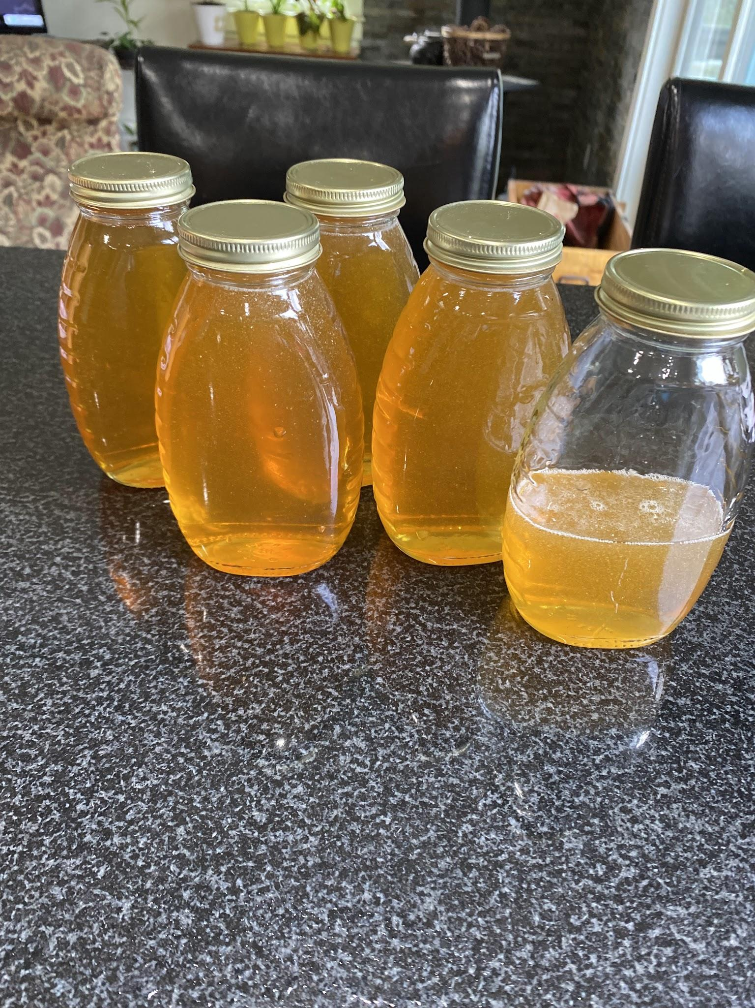
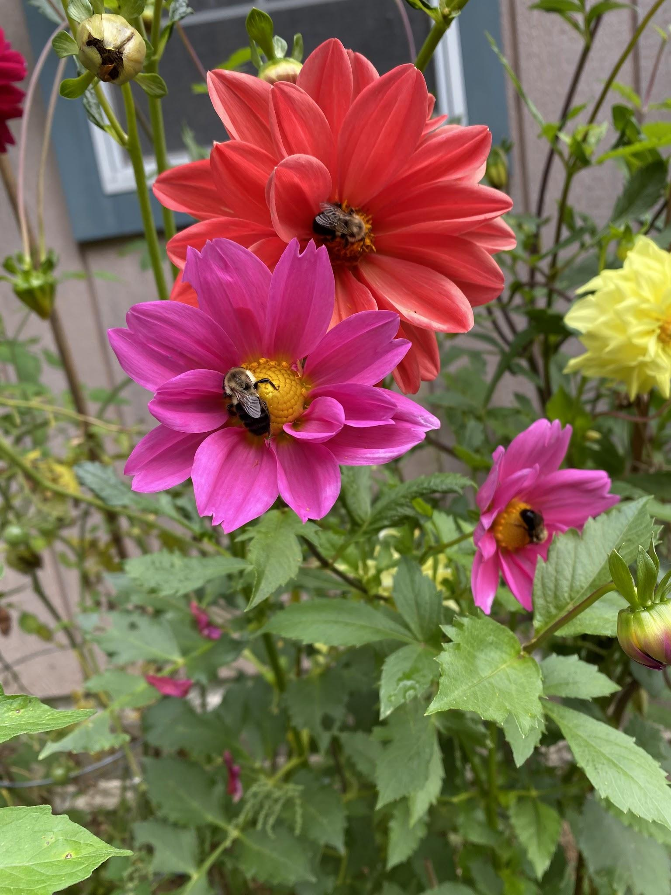
Pollinators and Bees
Notes:
Third year as a beekeeper

Slide 9
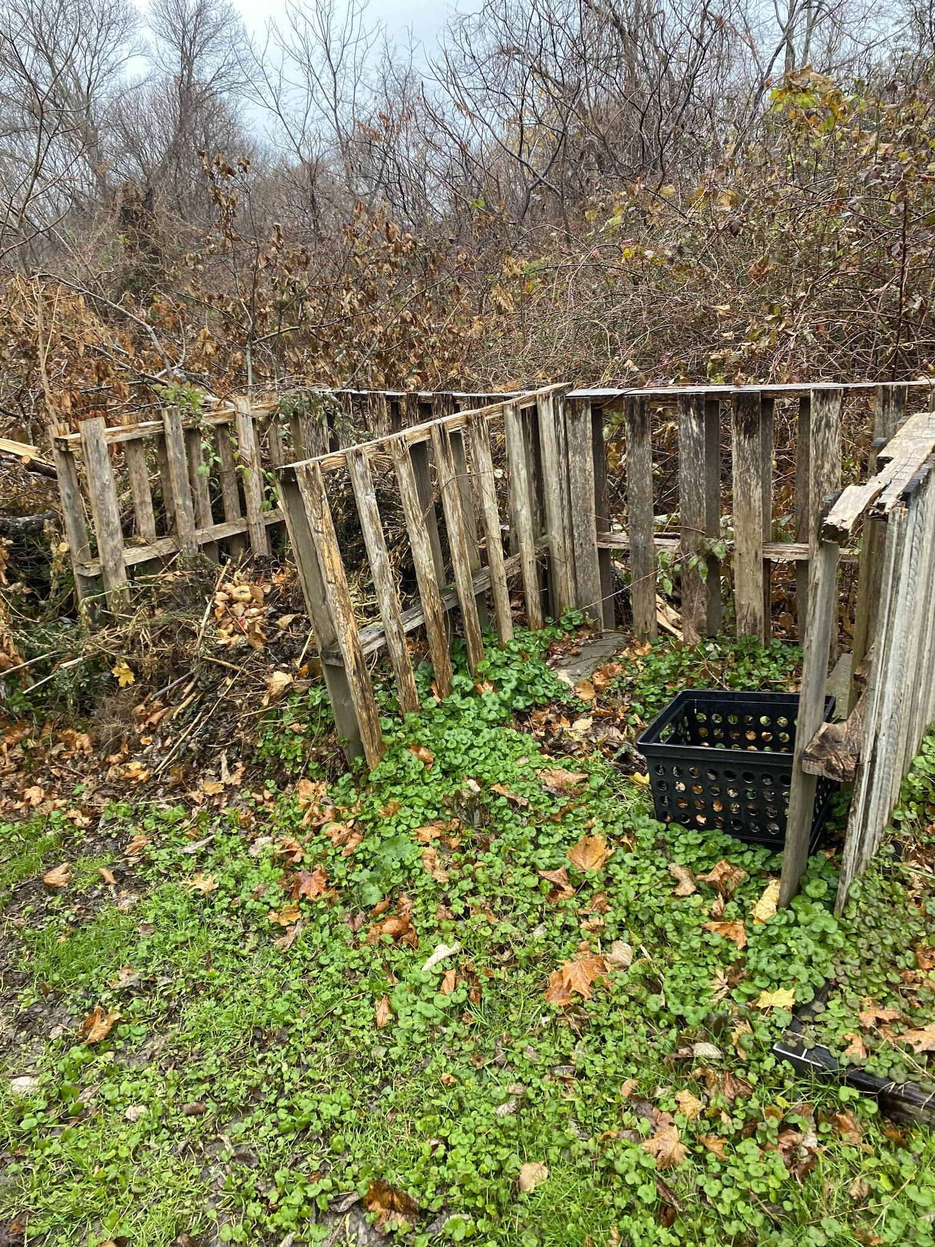
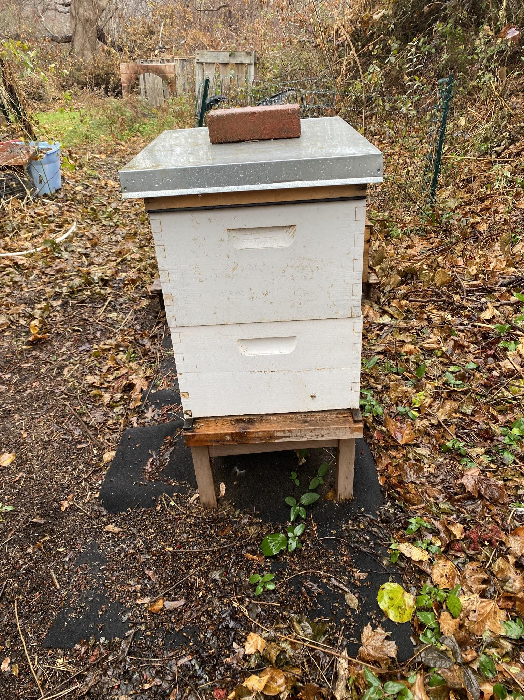
Compost System -Pallets
and Bee Hive
Notes:
Use pallets for composting, found materials for trellising and gardening.

Slide 10
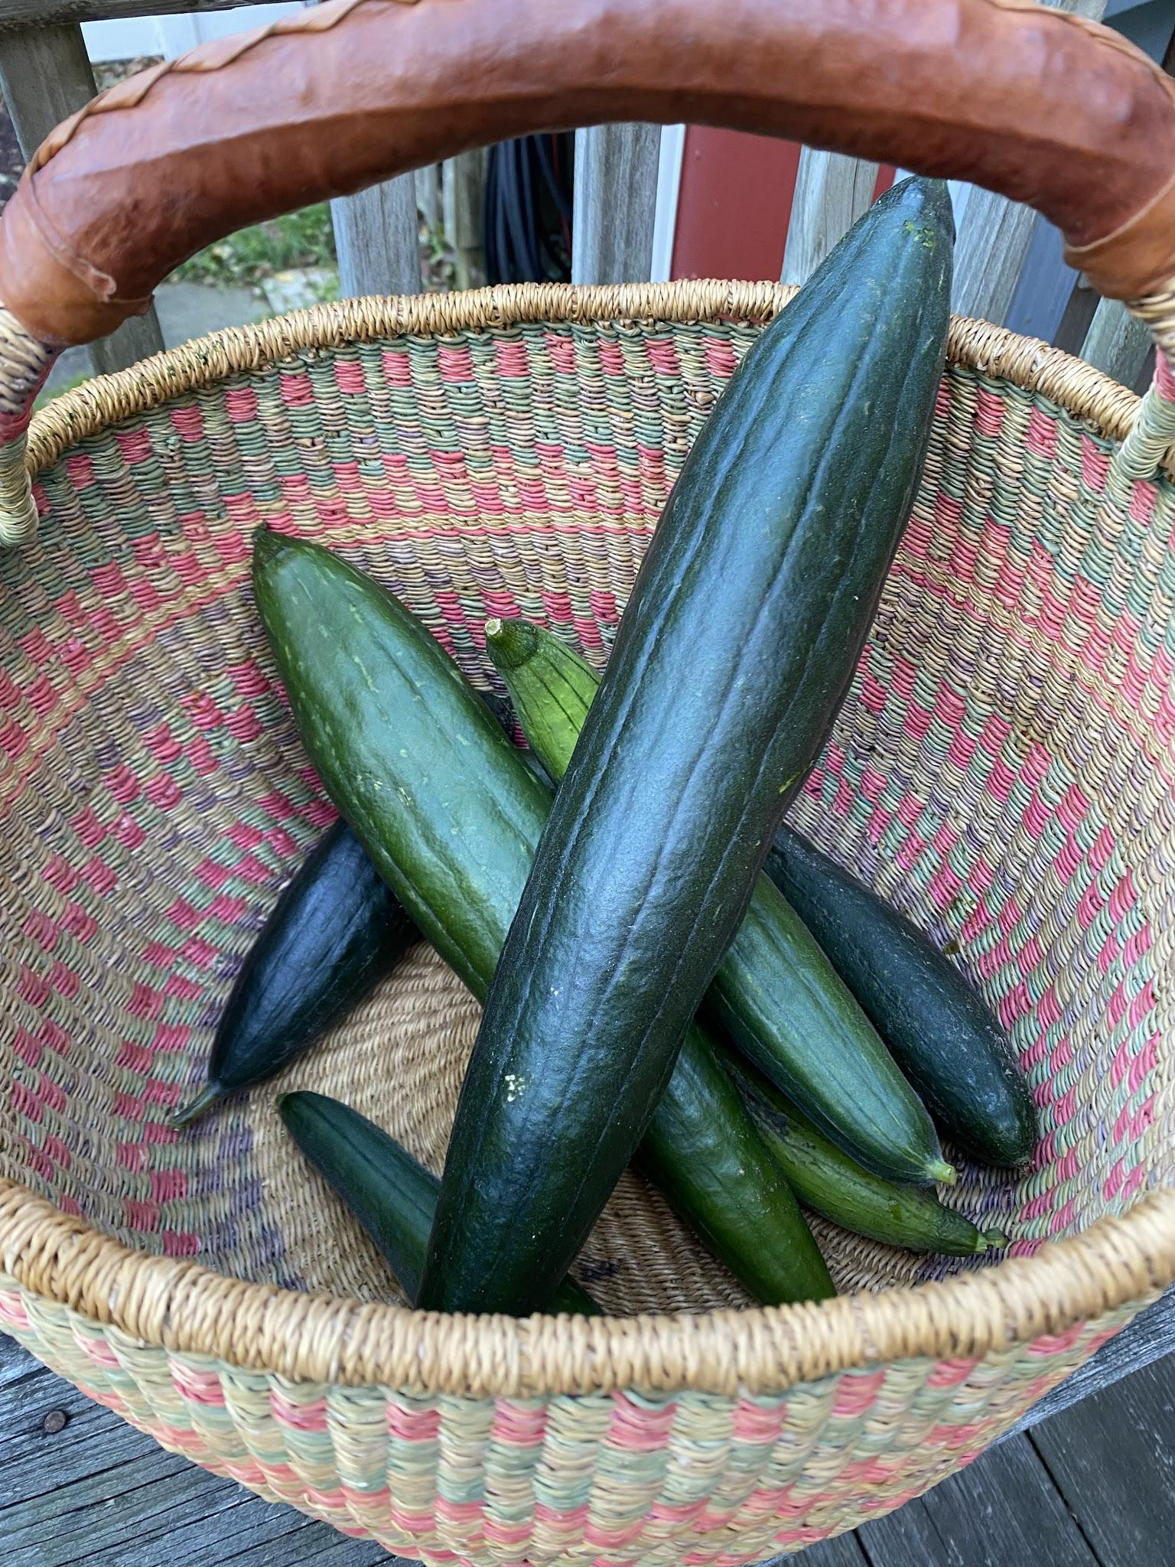
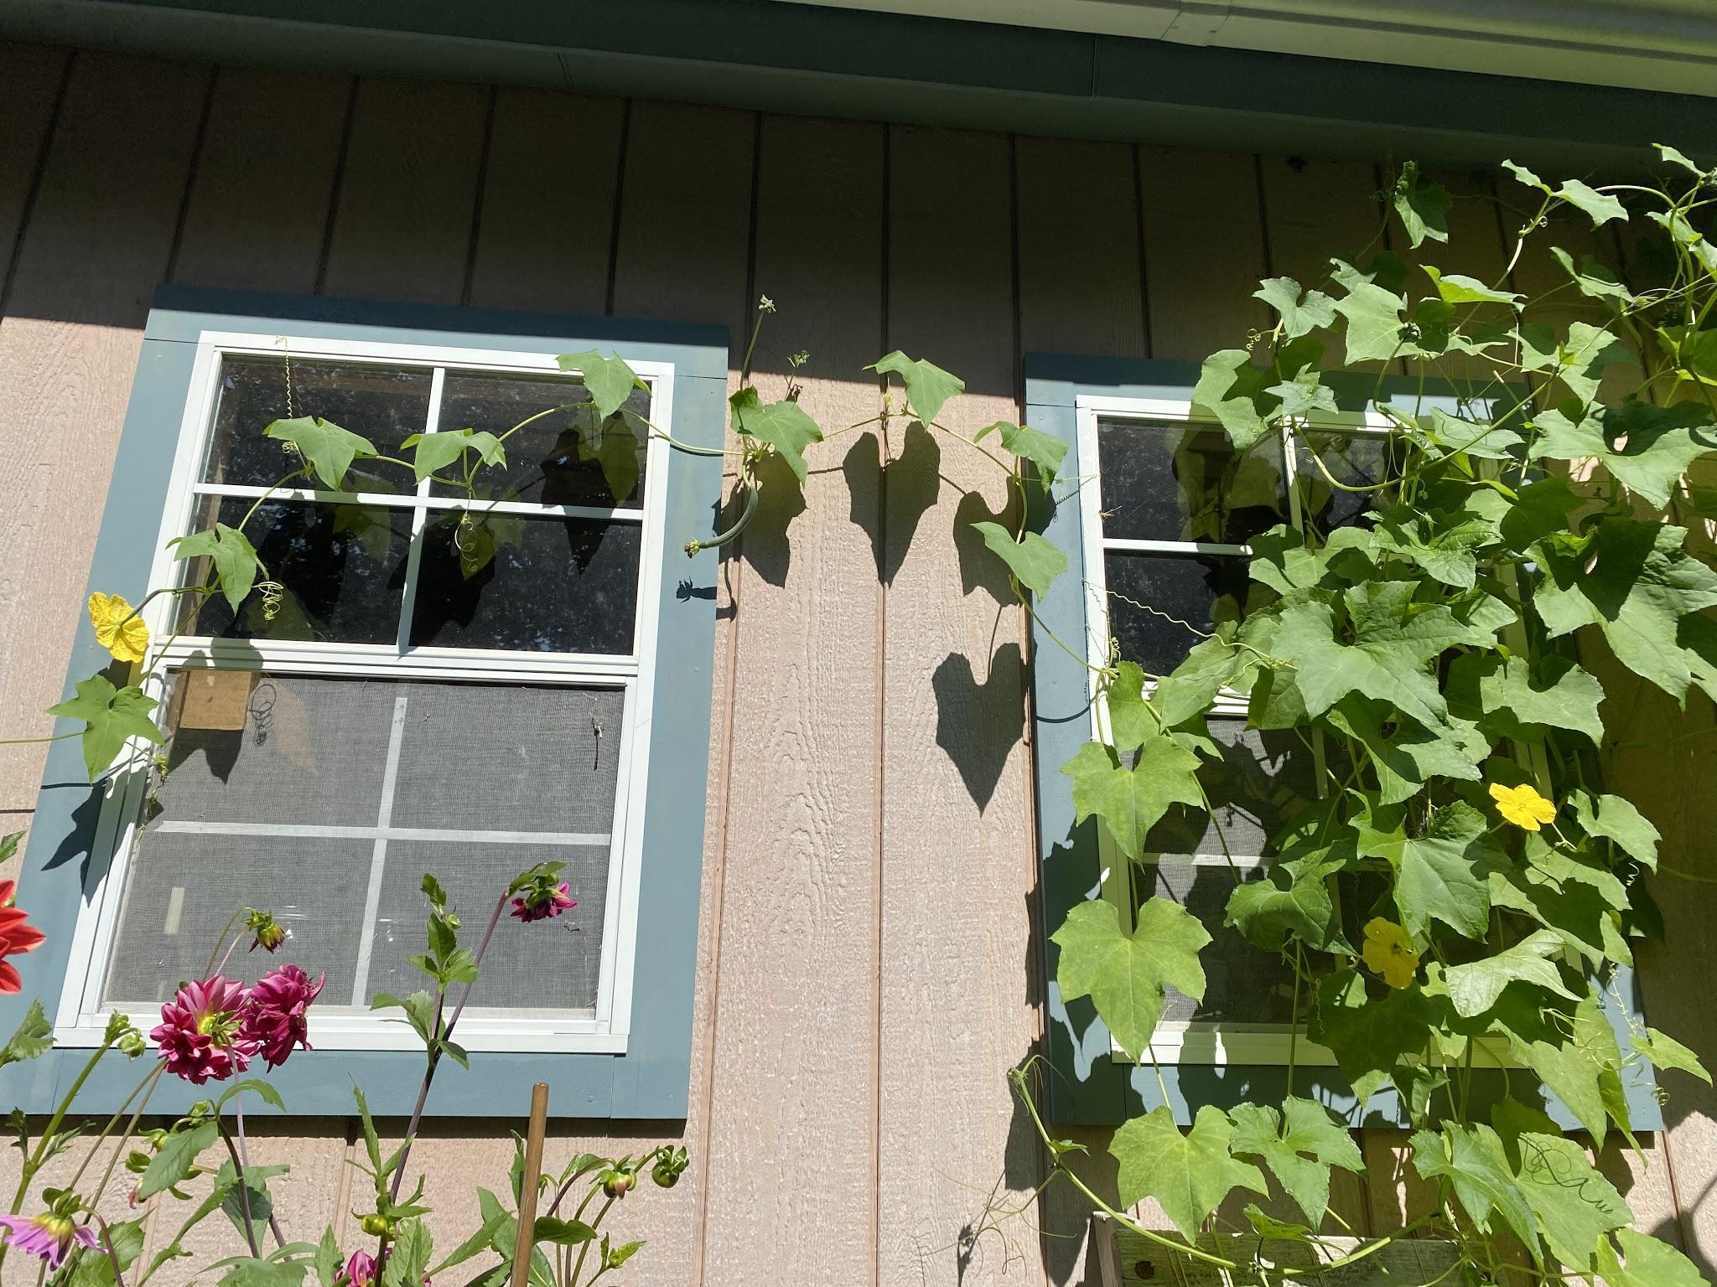
Loofahs are so cool!
Notes:
Try something new to grow. It is fun and rewarding. Youtube tells us everything

Slide 11
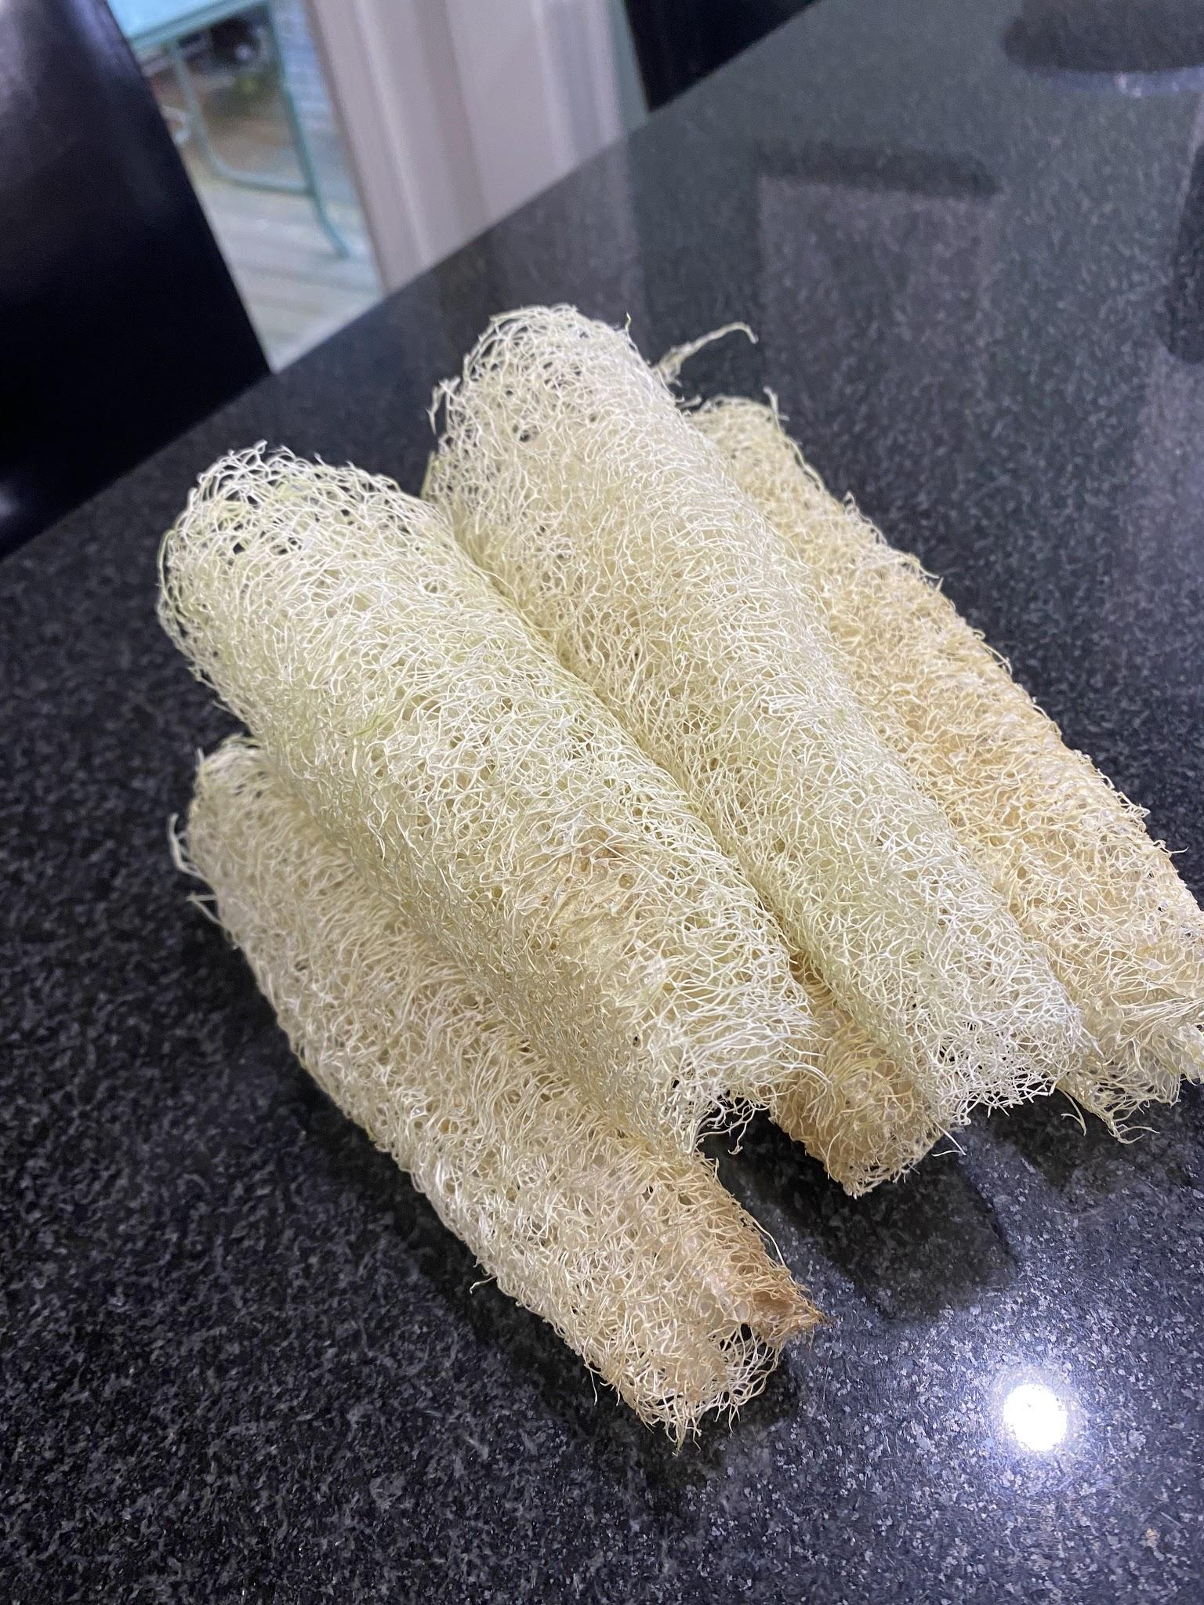
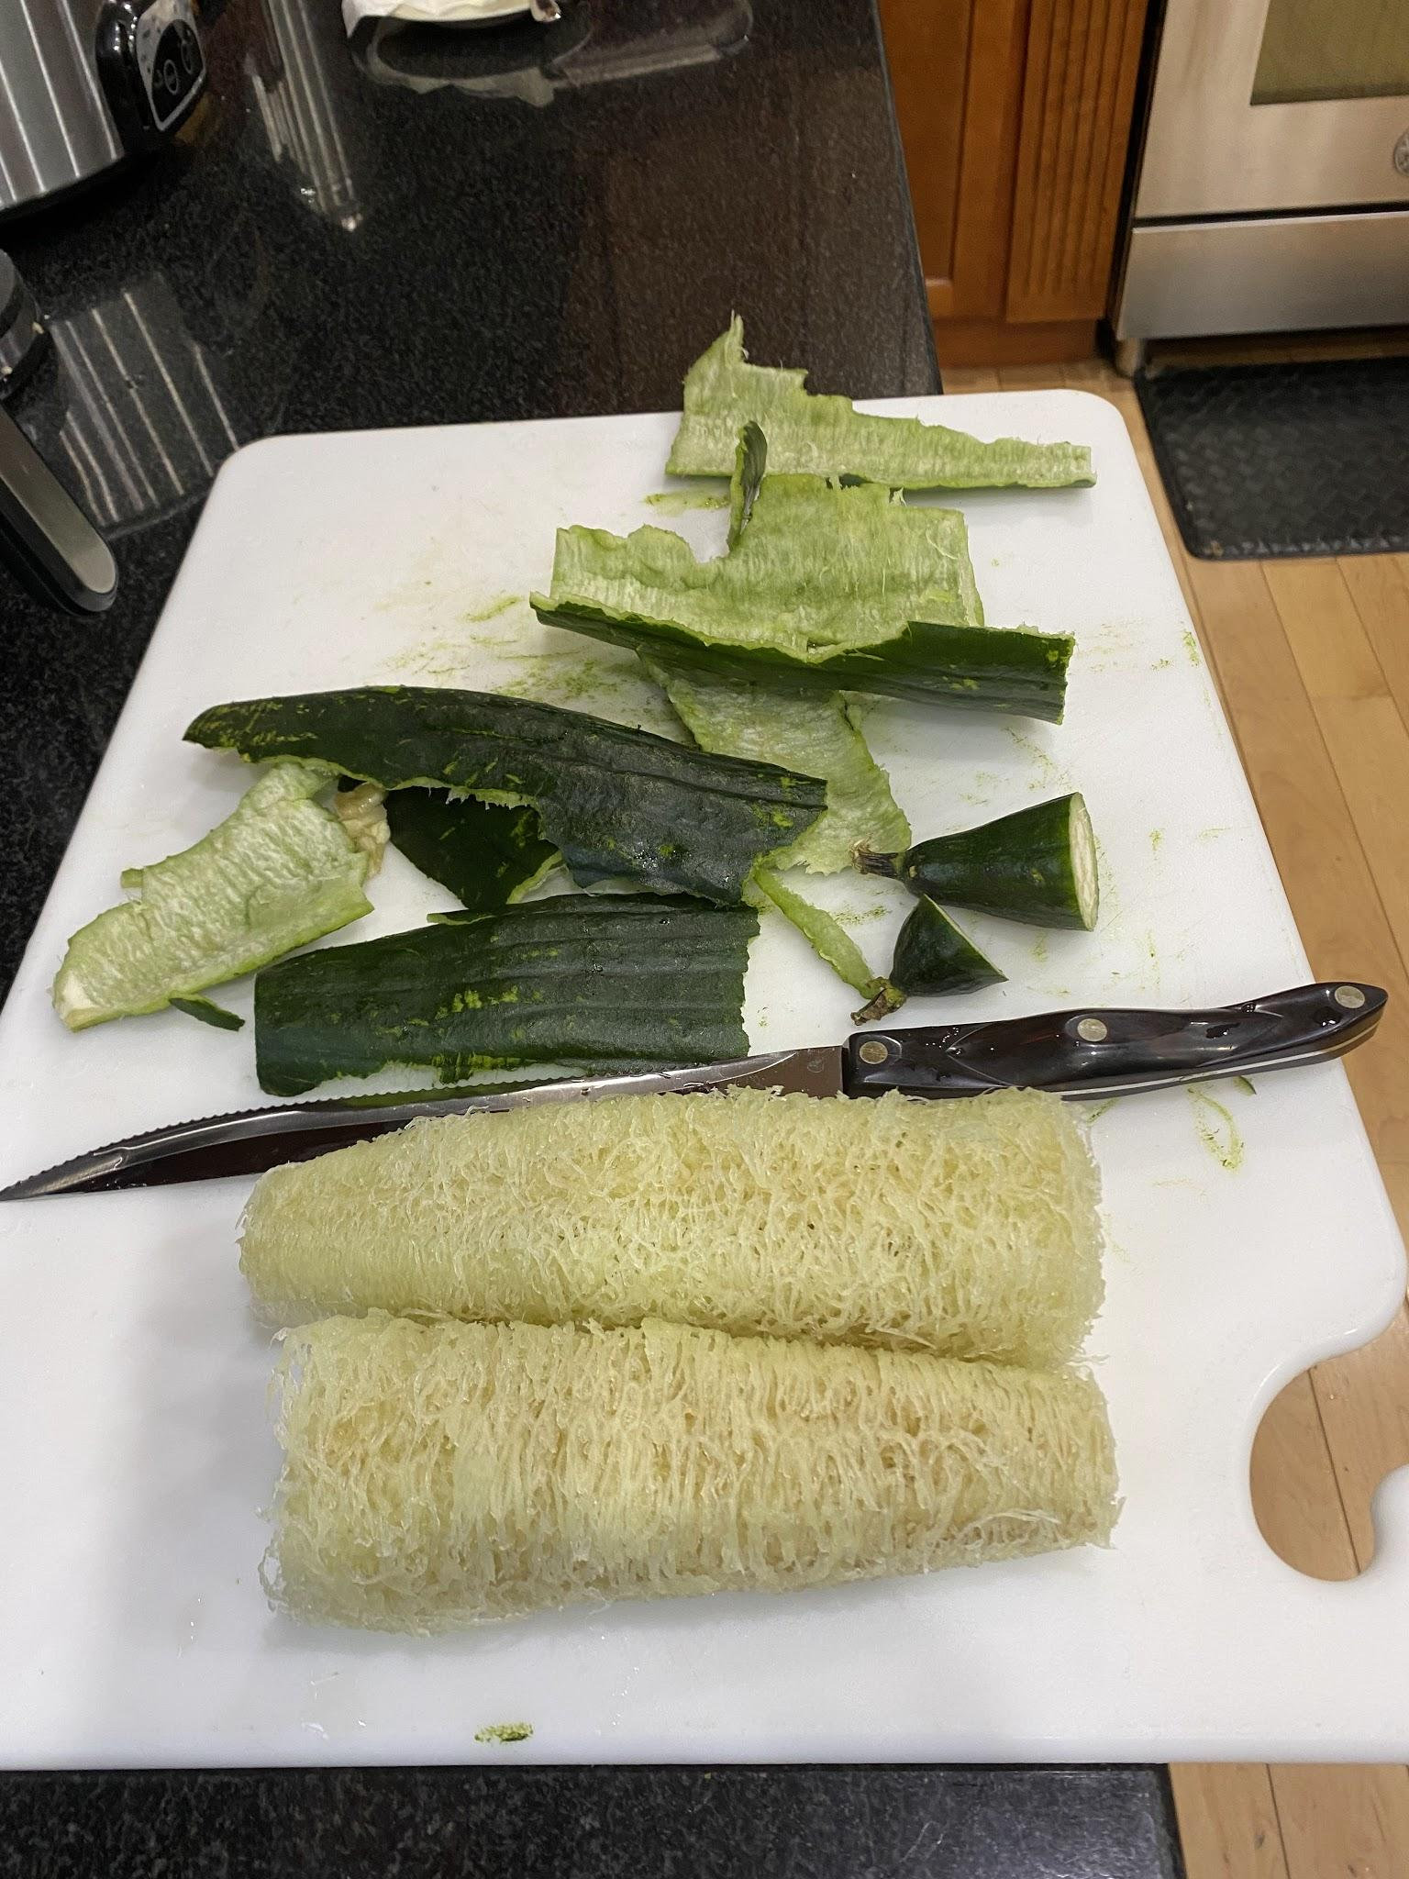
Processing for gifts.

Slide 12
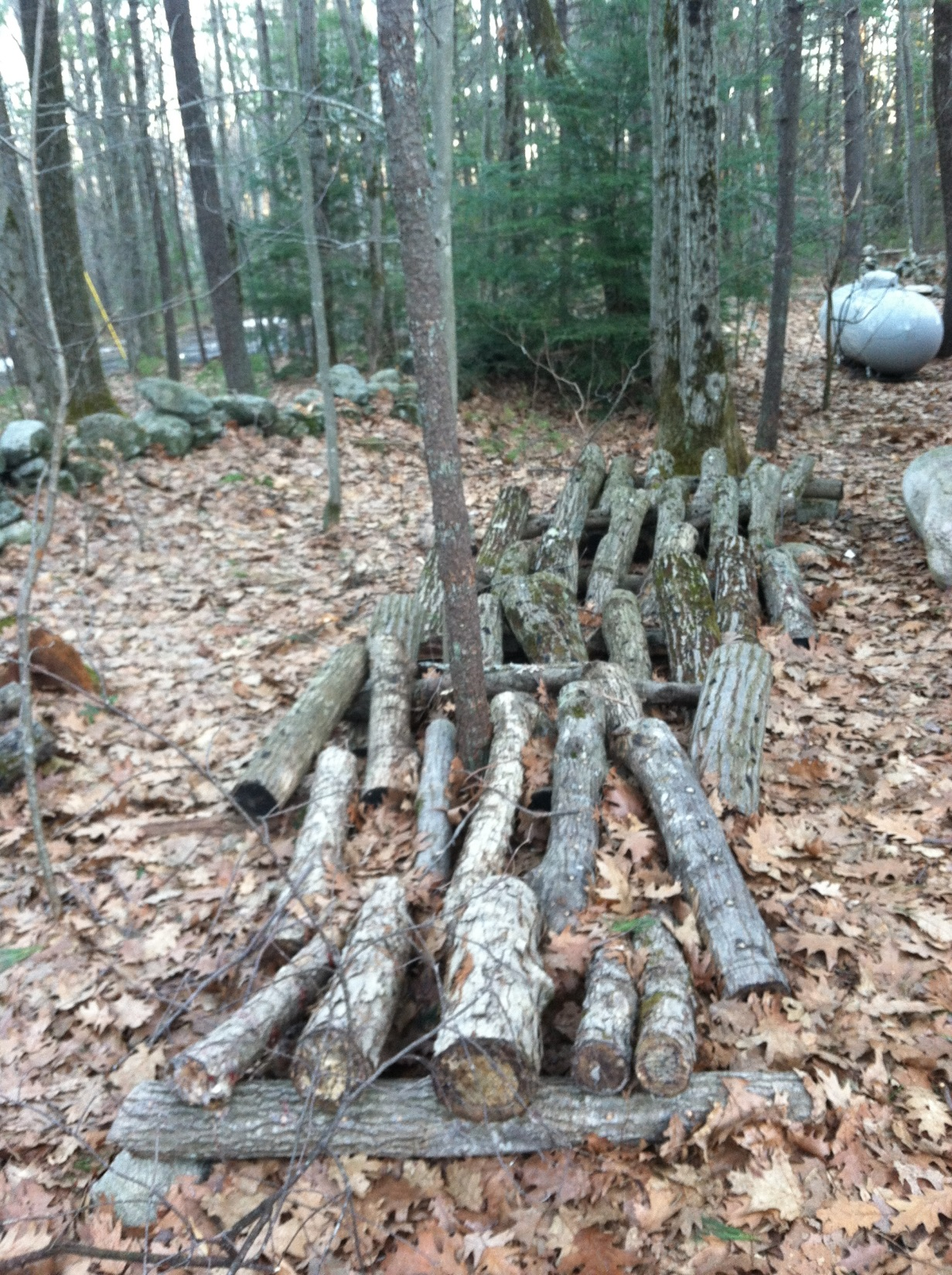
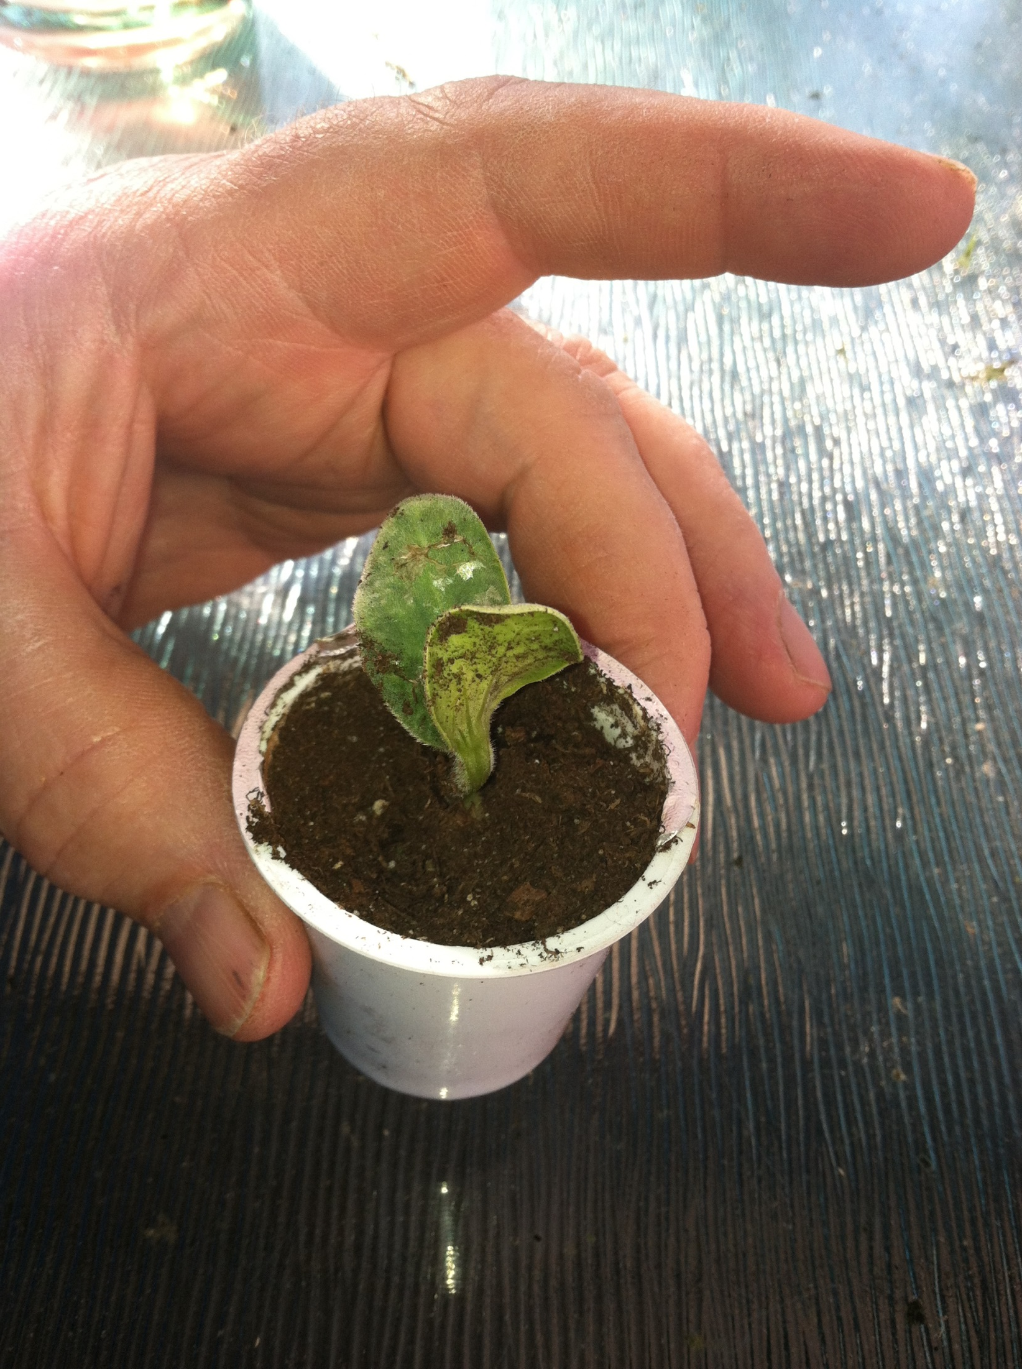
Shitake Mushroom Logs and
Re-using everyday items

Slide 13
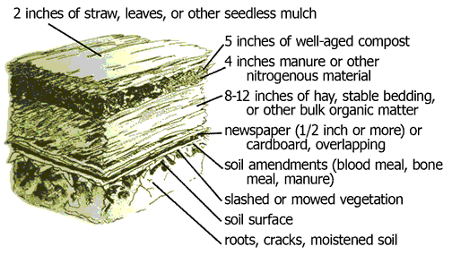
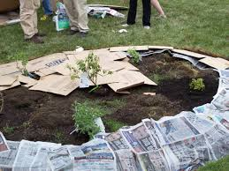
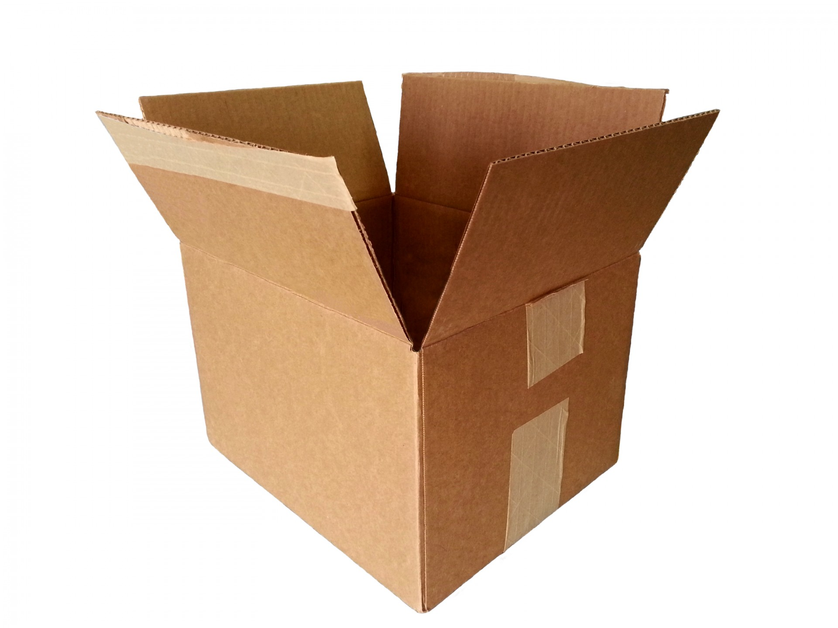
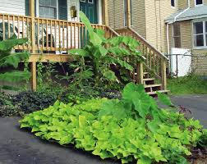
Yards to Production areas
Notes:
Cardboard uses. Take the tap off, weed barrier, sheet mulching.

Slide 14
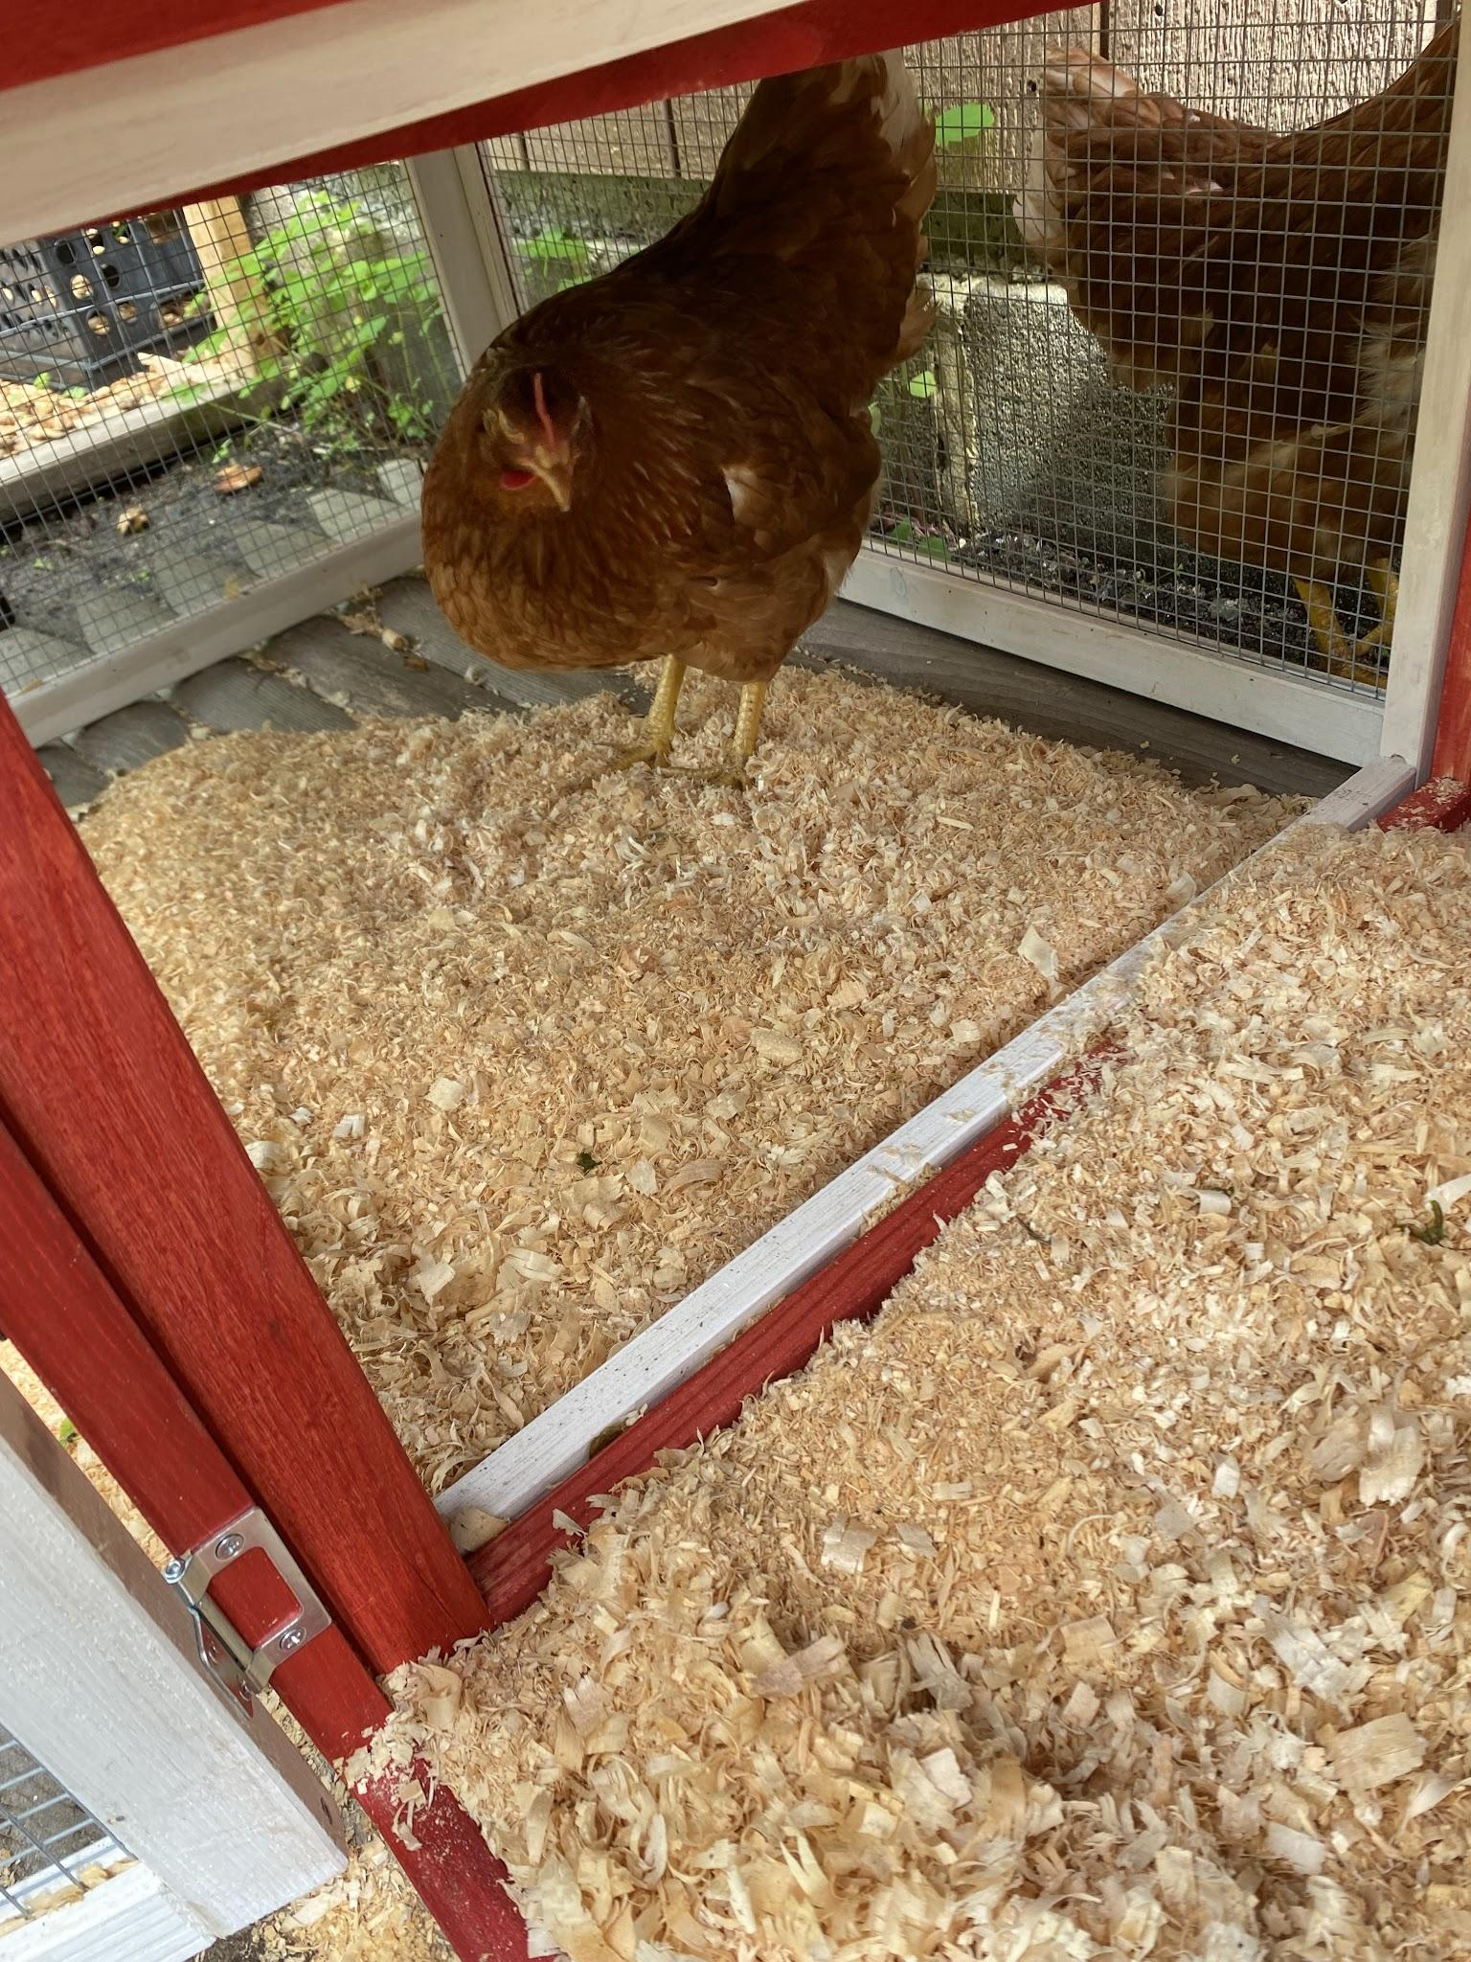
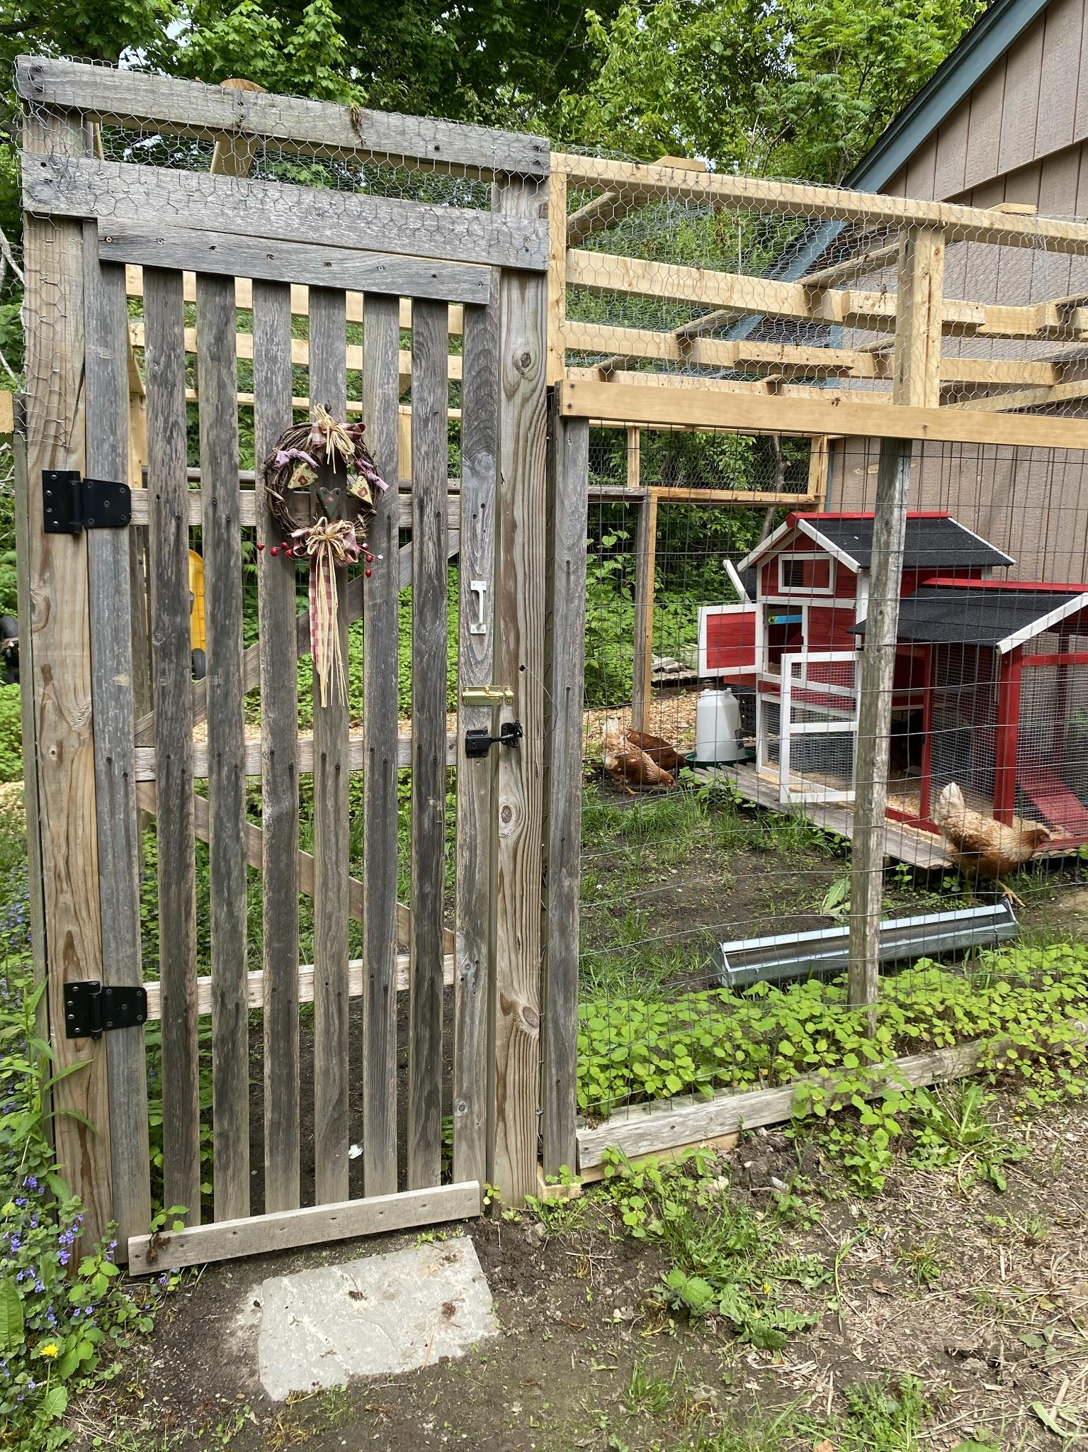
Chickens-Yield at home
Notes:
Eggs and the chickens are fun and control bugs at your house.

Slide 15
Zones of Use Permaculture Design
House, Zone 0, and then the zones radiat out. Located in Zone 1 are the things that you visit daily and are closest to the house. Herb Spiral, Kitchen Garden, Rain Barrel to water your plants.
Further away are the compost system, chickens, mushroom logs, fruit trees.
Less visited areas are further away.
Notes:
Start small and work you way up a little at a time. The pleasure is in the ding and trying and being a peace at home in nature.

Slide 16
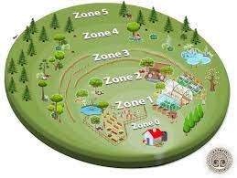

Slide 17
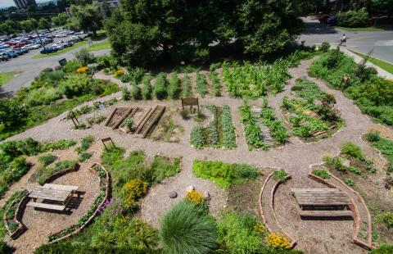
UMASS Amherst Permaculture Garden Dining Common

Slide 18
Resources
http://permacultureprinciples.com/
http://sowingsolutions.org/
http://www.umassdining.com/sustainability/permaculture
http://www.theatlantic.com/technology/archive/2015/03/the-abominable-k-cup-coffee-pod-environment-problem/386501/
http://www.cuesa.org/learn/how-far-does-your-food-travel-get-your-plate
http://endhunger.org/food-waste/
https://sivanandayogafarm.org/blog/what-are-the-permaculture-zones/

Slide 19
Books and Resources
Books
Edible Forest Gardens- Volume 1 and 2-Eric Toensmeier and Dave Jacke
The Vegetable Gardener’s Guide to Permaculture-Christopher Shein
Introduction to Permaculture- Bill Morrison
The Resilient Farmer and Homestead -Ben Falk
The One Straw Revolution-Masanobu Fukuoka
Paradise Lot-Eric Toensmeier
Movie
Inhabit

