Slide 1
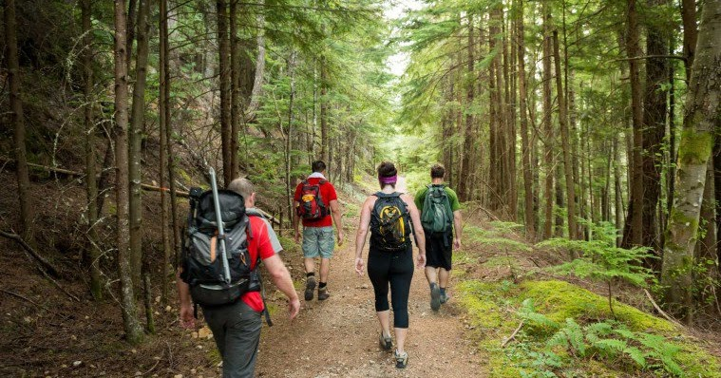
Hiking Trails along Fields and Forests above the
Plymouth / Carver Aquifer
This Photo by Unknown Author is licensed under CC BY

Slide 2
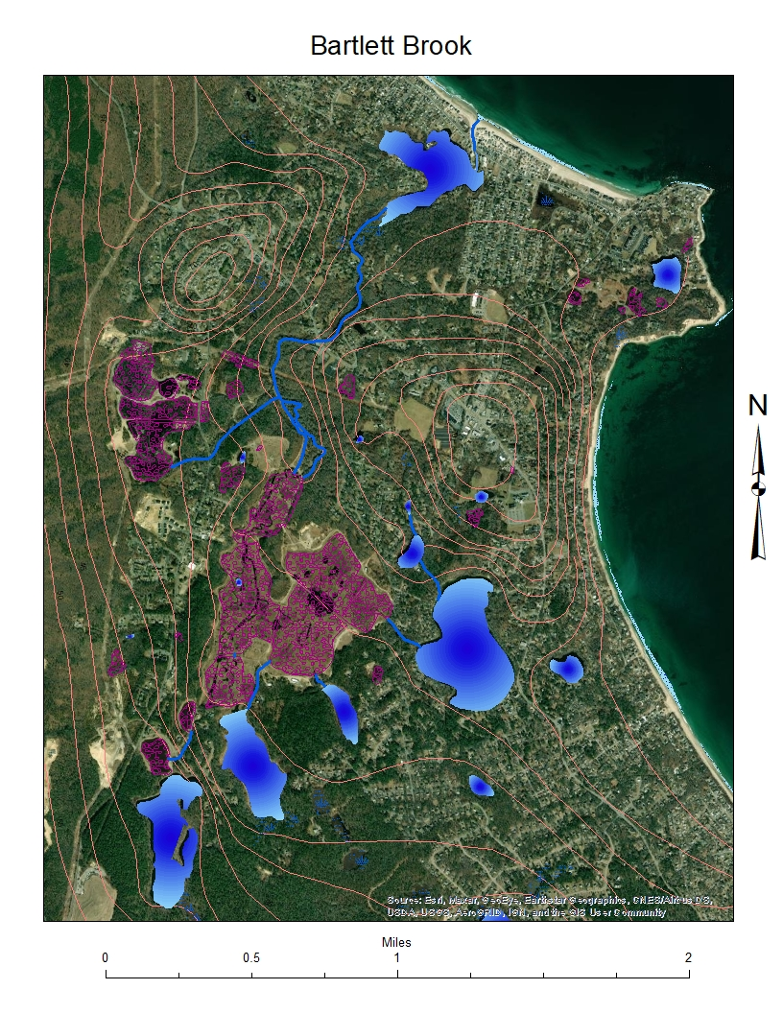
Plymouth Carver Aquifer
A segment of the aquifer is pictured on the right
This segment is the Manomet section of Plymouth Illustrating the surface elements of bogs, ponds, and streams and the connections between them.
The driving force creating these components is the aquifer illustrated by the topographic groundwater elevation lines in the diagram.
When the ground surface is lower than the aquifer elevation these elements begin to appear and connect.

Slide 3
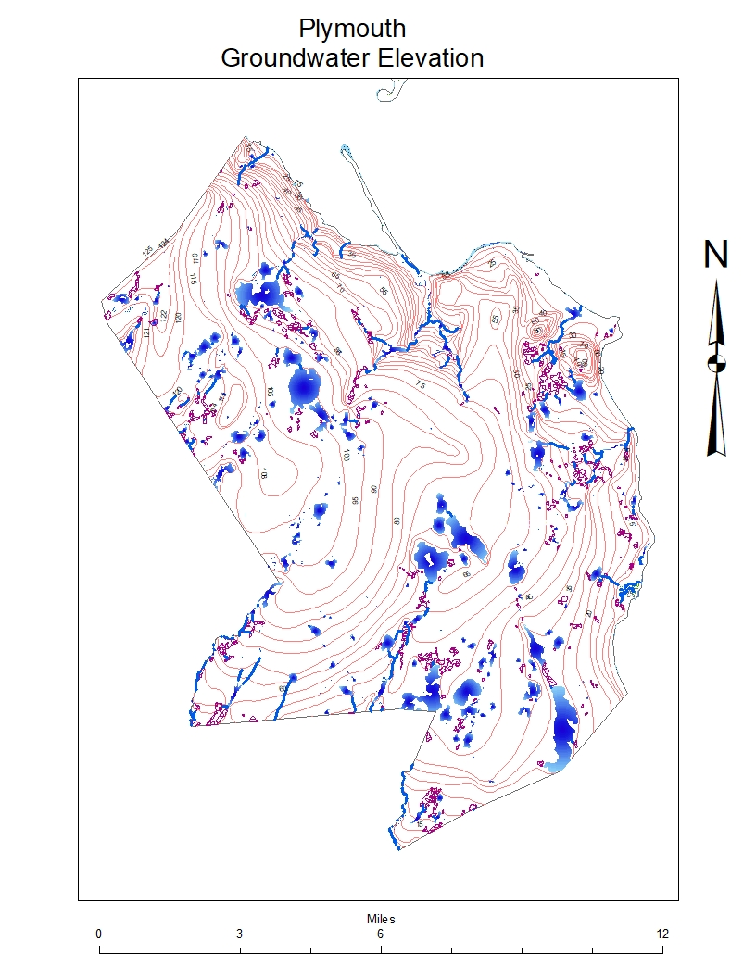
Plymouth section of the Plymouth Carver Aquifer
This aquifer is the source of many local ponds, and streams. The aquifer is represented by the topographic lines. As can be seen in the diagram ponds and streams result from the intersection of the surface with the aquifer.
Easterly flowing streams
Town Brook
Eel River
Bartlett Brook
Indian Brook
Savery Brook
Southwesterly Flowing streams
Herring River
Agawam River
Wankinko River
Weweantic River

Slide 4
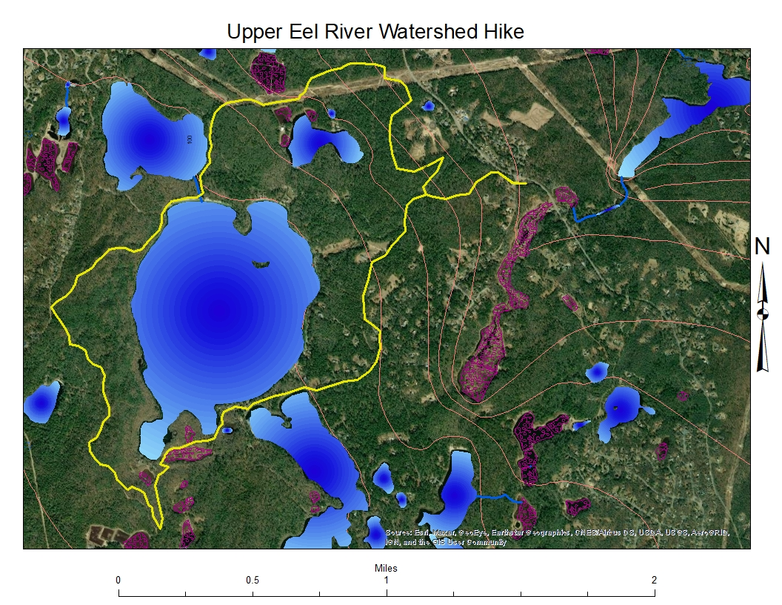
The Upper Eel River Watershed hike offers:
Beautiful Pond views
Spectacular views from Pinnacle Hill
White Sandy Beach
Many miles of a woodland hike
Hilly terrain
The 7 mile hike begins on Long Pond Road at the Eel River parking lot proceeds west and then north to town conservation land. Next the hike moves west and southwest to Little South and Great South Ponds with sandy beaches. Over Pinnacle hill for great views then on through the woods to the Great South and Boot Pond connection. Finally an old cart path, then Fuller Farm Road to the parking lot

Slide 5
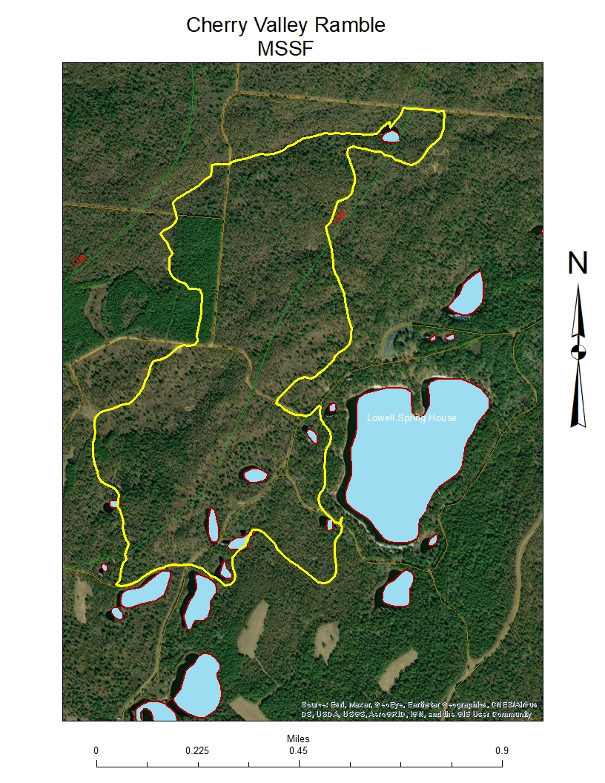

Cherry Pond Valley Hike offers:
Moderately hilly terrain
Hike through an ancient glacial valley
Many pond and kettle hole views
Small glacial depressions with unique vegetation
The 5 mile hike begins near College pond on Federal Road. Proceeds to the north through native forest to a large long depression, perhaps an ancient glacial lake. Proceeding south the land rises to a white pine forest then through fields to a number of kettle hole ponds. The string of ponds establishing the headwater of the Wankinko River at the forest headquarters

Slide 6
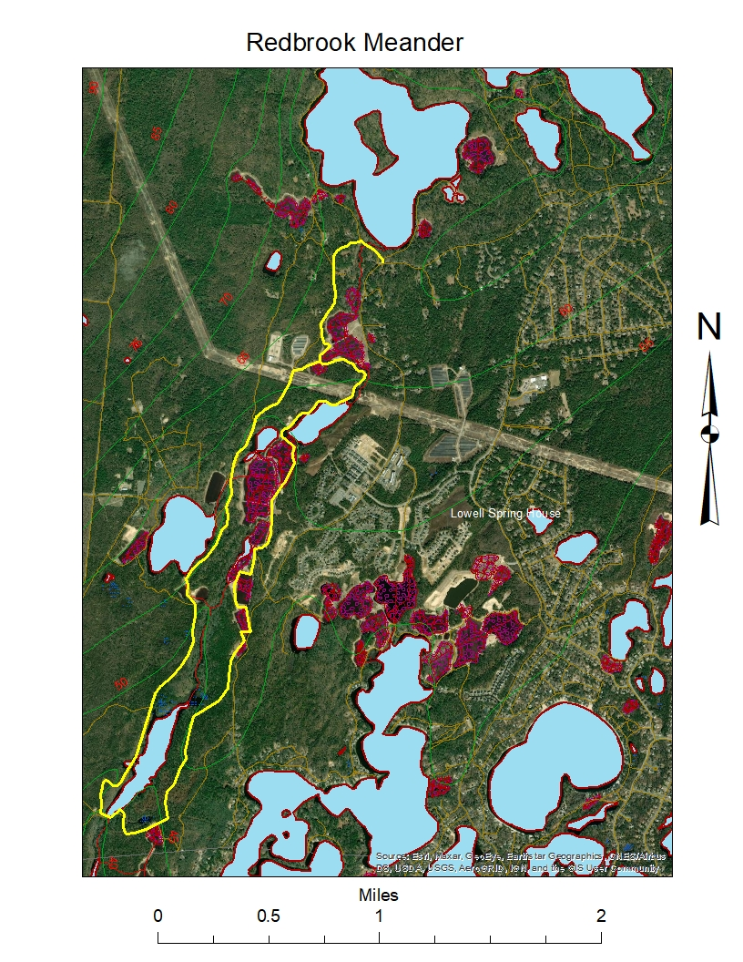
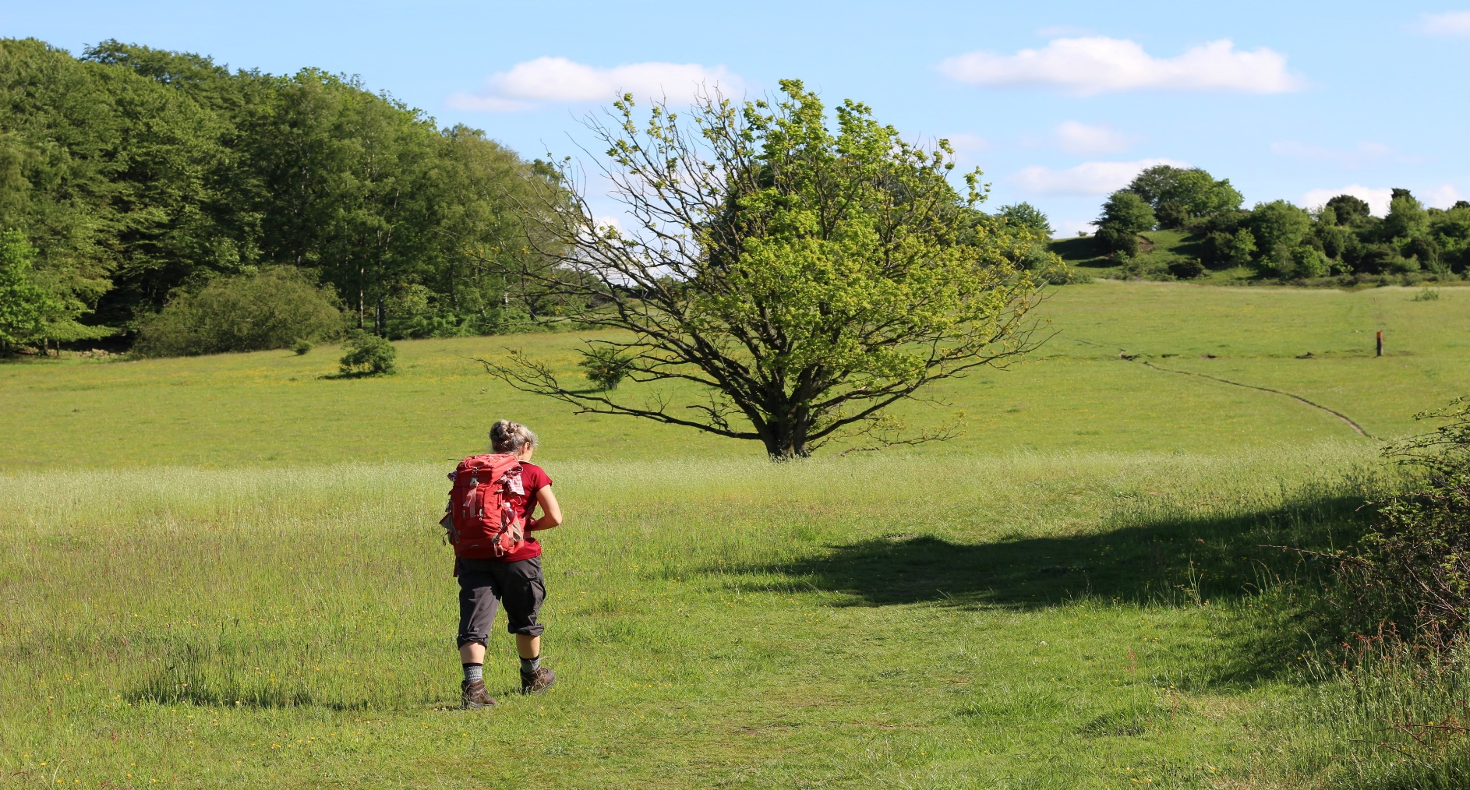
Redbrook Hike Offers
Flat terrain
Wonderful stream and bog views
Redbrook village
Agawam River dam
This 6 mile hike proceeds south at Halfway Pond, headwater of the Agawam river. The trail follows the river past Redbrook Village along bog roads and woodland footpaths near the dam. The dam is on the Plymouth Wareham town boundary. Then the hike shifts to the north along Agawam Rd, the Myles Standish State Forest boundary, back to Halfway Pond.

Slide 7

Hiking trips are plentiful above the Plymouth/Carver Aquifer
with many opportunities for adventure

